Slide 1


Goodbye Blogs, Hello Communication Sites
Melanie Culver
@CulverMelanie​
Brought to you by:
The Global Microsoft Community &
#M365VM
M365VirtualMarathon.com
M365Conf.com | #M365CONF

Slide 2
Session Description
End of last year Microsoft announced that delve blogs and classic SharePoint blogs will retire. The grace period granted by Microsoft was only "6 months" until normal users were not able to create new blogs. No worries, they will still continue to function though. Some organisations heavily invested in using this functionality, for example in their classic intranet, so a transition is not that easy.
This session will not only have a look at what great tools the PnP Team has provided, such as the modernisation scanner and several guides, but also elaborate on a possible approach to transform and restructure your content to still be accessible in your intranet.
Highlights
Migration path from blogs to communication sites
PnP tool set for the modernisation of your portals
Classic Intranets with Modern Communication Sites

Slide 3

Mark Your Calendars:
March 23-25, 2021, MGM Grand Resort
Las Vegas, Nevada, USA
M365Conf.com
#M365CONF
The SharePoint Conference is now The Microsoft 365 Collaboration Conference
Brought to you by:
The Global Microsoft Community &
#M365VM
M365VirtualMarathon.com
M365Conf.com | #M365CONF

Slide 4










THANK YOU TO ALL OUR GENEROUS SPONSORS

Slide 5

ARE YOU READY FOR A RAFFLE? We are giving away 3 Oculus Quest All In One!
Visit the Vendors Booth, Sessions and Watch the Videos
Submit Your Answers to Enter the Raffle
You need at least 5 correct answers then submit for a chance to win one of 3
(One in each Americas, APAC, EMEA)
https://bit.ly/m365raffle

Slide 6





CONSIDER DONATING TO THE FOLLOWING CHARITY RELIEF FUNDS: UNITED WAY OR INTERNATIONAL MEDICAL CORPS
THANK YOU FOR JOINING US! 10% OF FUNDS FROM SPONSORS GO TO SUPPORT COMMUNITY RELIEF
United Way: https://give.uwkc.org/M365VM
International Medical Corps: https://bit.ly/MedicalCorpsFund

Slide 7




Melanie Culver
Consultant & Solution Architect M365
International Organisation
Vienna, Austria
Brought to you by:
The Global Microsoft Community &
#M365VM
M365VirtualMarathon.com
M365Conf.com | #M365CONF

Slide 8
Agenda
Status Quo
Assessing the options
Possible Path
Let´s get down to it
Q&A

Slide 9
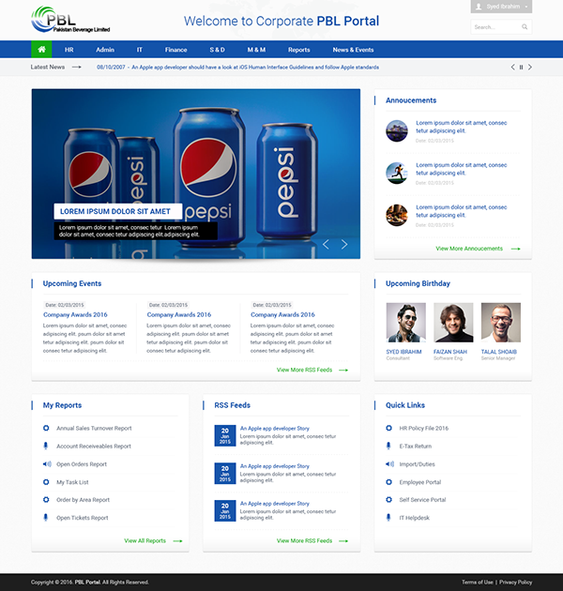
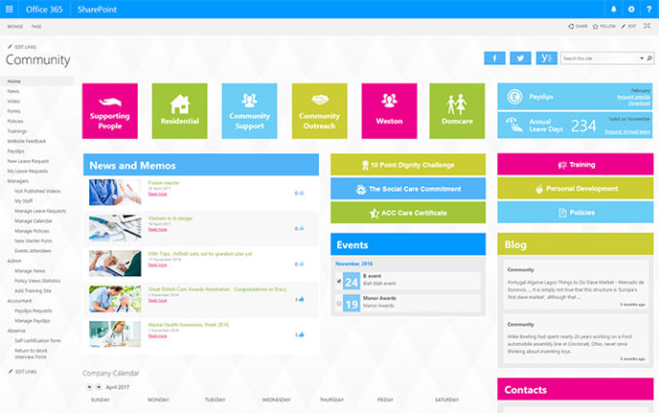

Slide 10


Slide 11
And then …..
Brought to you by:
The Global Microsoft Community &
#M365VM
M365VirtualMarathon.com
M365Conf.com | #M365CONF

Slide 12


Slide 13
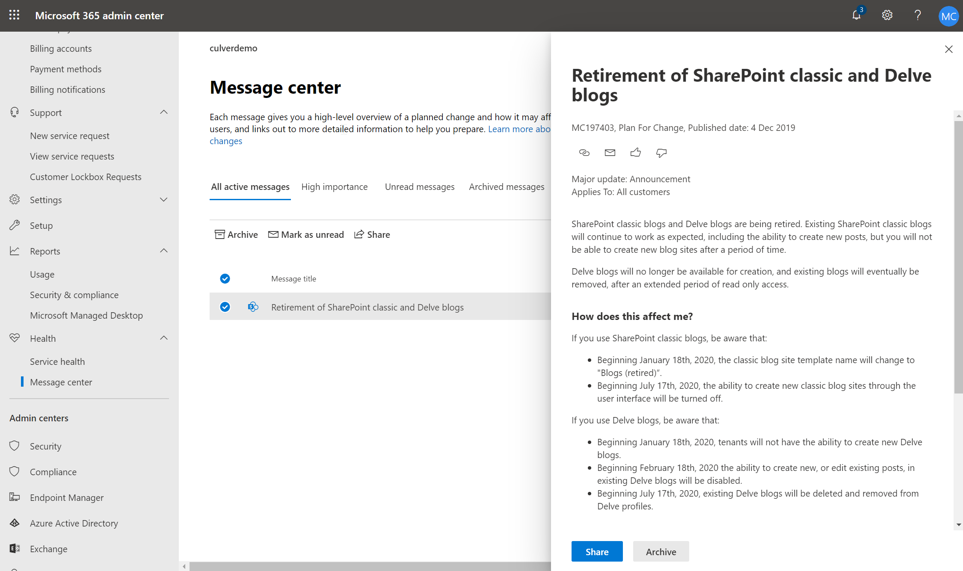

Slide 14
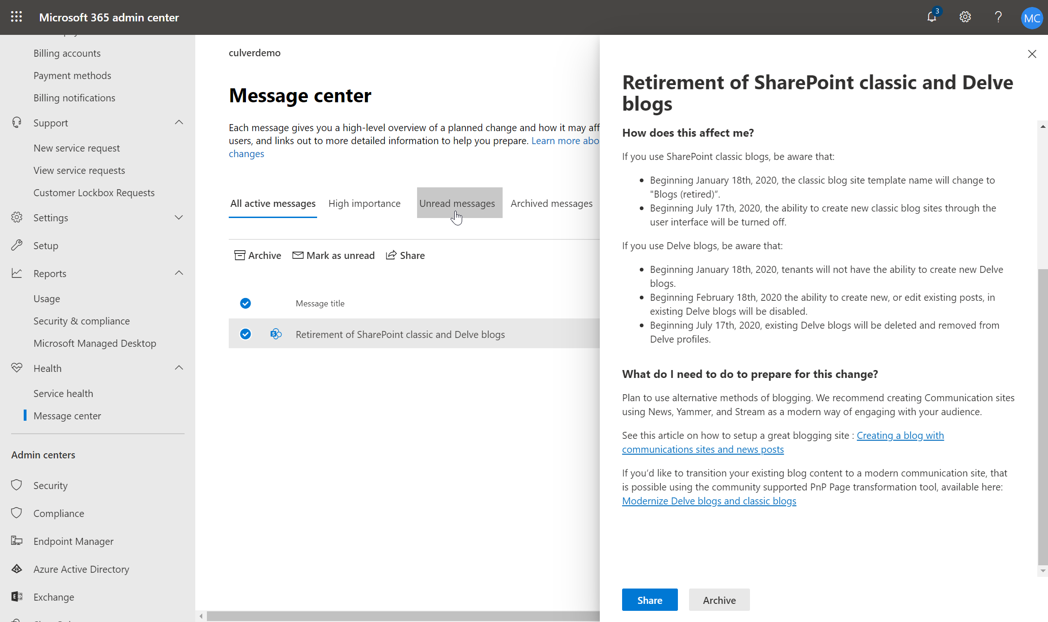

Slide 15

Notes:
Pic:Question

Slide 16

Notes:
Pic: Path

Slide 17
Current Intranet
Classic SharePoint with publishing features
Blogs to communicate content
WebPart that aggregate the content
e.g. Content Search, Custom JavaScript
Invested time and money
A lot of content

Slide 18
Steps to take
Assess number of Blogs and activities
Assess the customisations
Identify and assess the different options
Draft a plan
Execute the plan

Slide 19
1. Assess number of Blogs and activities
Modernizer Scanner
https://docs.microsoft.com/en-us/sharepoint/dev/transform/modernize-scanner
Or if you are Tenant admin search ☺
webtemplate:blog
Look at
Number of blogs
Identify Owners
Activities and Usage
Permissions
Notes:
https://github.com/pnp/PnP-Tools/tree/master/Solutions/SharePoint.Search.QueryTool

Slide 20
2. Assess the customisations
Additional fields
Look & Feel
Custom layout
Content Aggregation / WebParts
…..

Slide 21
Demo
Notes:
Demo 1
Modernizer Scanner
Search Query
Look at your customisations

Slide 22
3. Define and assess the different options
Full Migration of Intranet
Migrate blogs to communication sites
Don‘t do anything
Create „modern“ blogs as of now
Migrate to classic publishing pages

Slide 23
3. Comparing Options
Option | Pro | Con
Don‘t do anything | No effort required | Miss out the fun MS will not invest anymore Will have to be done sooner or later
Create „modern“ blogs as of now | You can join the fun with new content | Integrate into existing intranet + above
Migrate to classic publishing pages | You stay in the eco-system you know | Migration effort required + above Is it really worth it?
Migrate blogs to communication sites | Benefit of the new communication sites Heading in the direction MS would like you to go | Effort to migrate Effort to integrate
Full Migration of Intranet | Make the most of communication sites | Major effort

Slide 24
3. Some considerations
You do not have to do a big bang migration
You will have to rearchitect the technical structure
No more SubSites!
Define your new look and feel -> LookBook
Theme
Blog page content
Permission model

Slide 25

4. Draft a plan

Slide 26

5. Execute the plan

Slide 27
Blogs -> Communication Sites
Brought to you by:
The Global Microsoft Community &
#M365VM
M365VirtualMarathon.com
M365Conf.com | #M365CONF

Slide 28
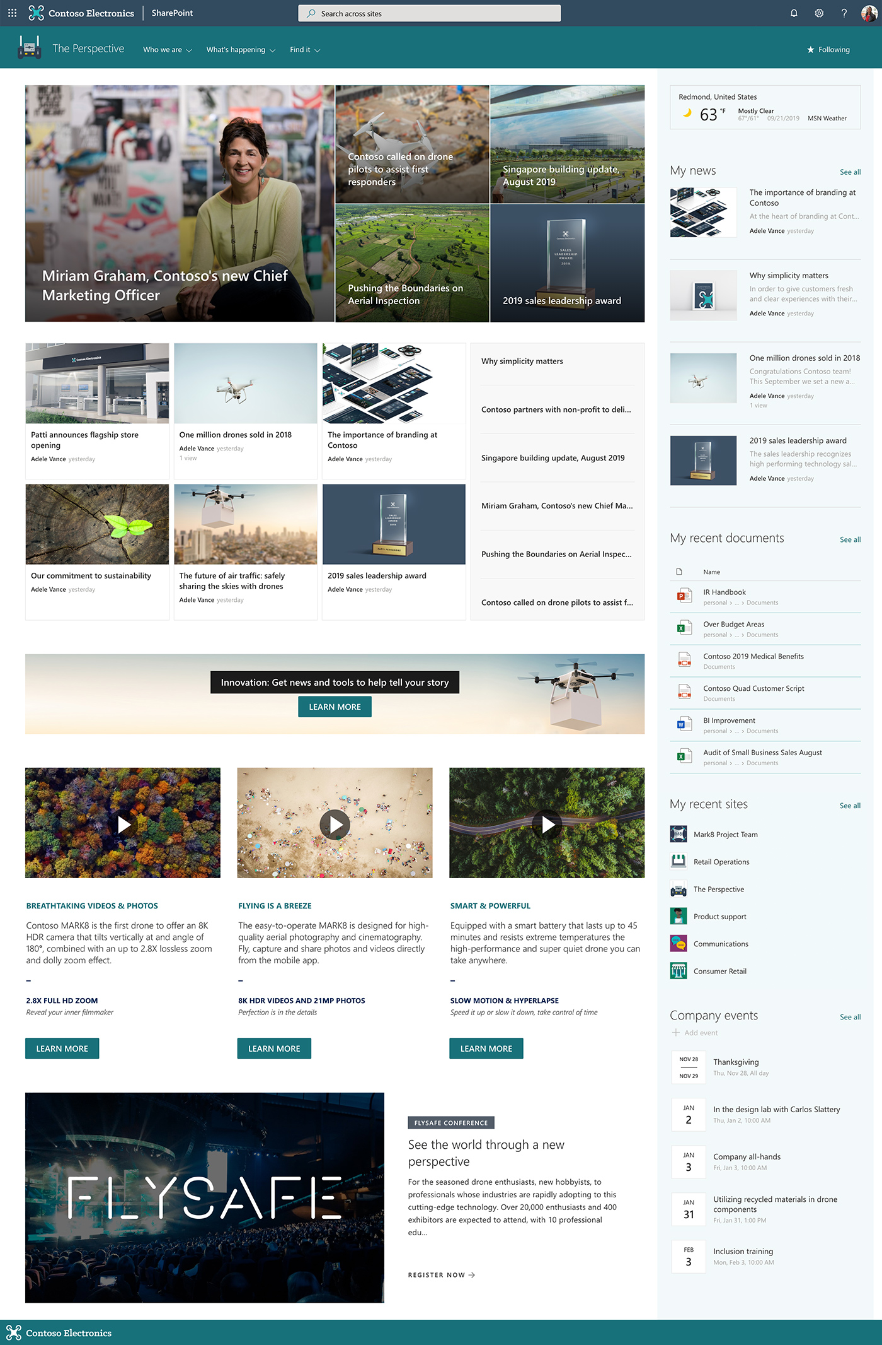

Slide 29
Communication Sites
The new (for a while)
= Site Collection
Hub Sites
Modern design, with little to customise (ideally)
Custom Page Layouts …. Yes/No

Slide 30
Structure Now
Intranet
Organisation
News
Vision
Corporate
History
Facts & Figures
News Center
Media
Knowledge Base
SharePoint
OneDrive
Events
Work
Administration
Rules & Regulations
Communication
IT
Security
Collaboration
Project Spaces
Departments
IT
Marketing
Sales
HR
Finance

Slide 31
Structure Future
Sales
Finance
Intranet
Vision
Corporate
History
Facts & Figures
News
Events
Project Space
Legal
Rules & Regulations
IT
Marketing
Media
Share
Point
OneDrive
HR
Client Devices
Security
Communi-cation
Administration

Slide 32

ConvertTo-PnPClientSidePage -Identity $postTitle -BlogPage -Overwrite -TargetWebUrl $TargetUrl -KeepPageCreationModificationInformation -PostAsNews -SetAuthorInPageHeader -CopyPageMetadata
<<
<<
https://docs.microsoft.com/en-us/sharepoint/dev/transform/modernize-guidance
https://docs.microsoft.com/en-us/sharepoint/dev/transform/modernize-blogs

Slide 33
Process
Create Communication Site
Prepare Communication Site
Custom columns
Transform

Slide 34
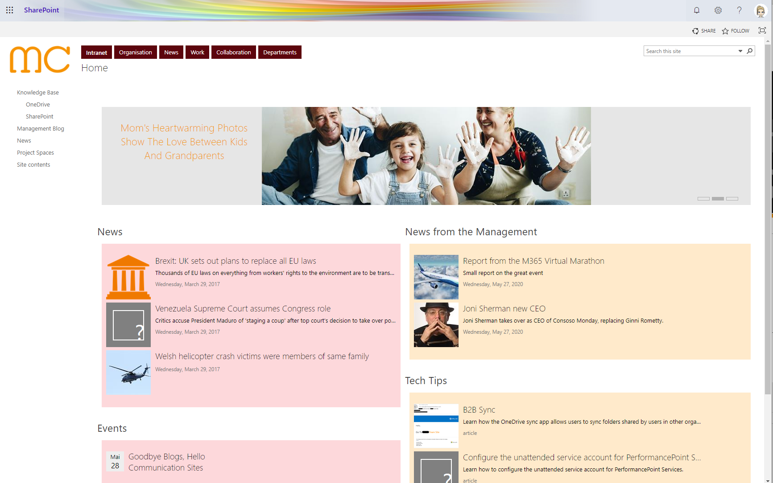
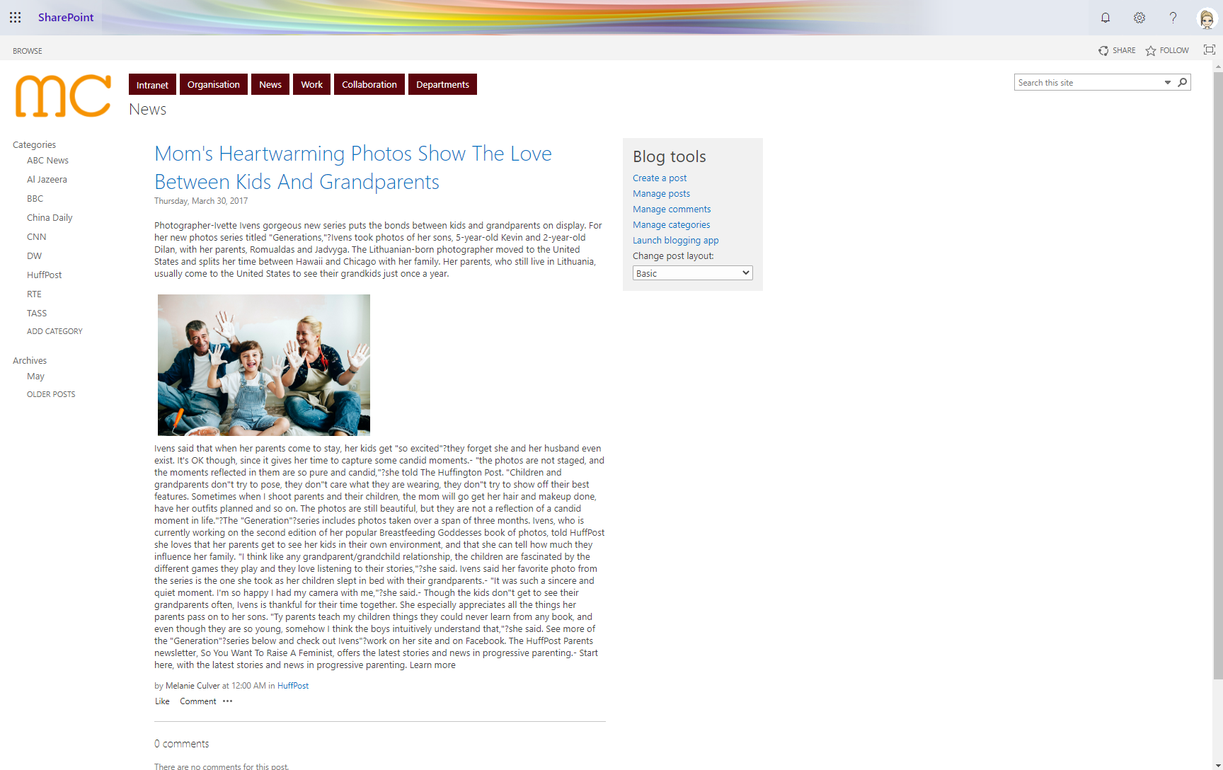

Slide 35
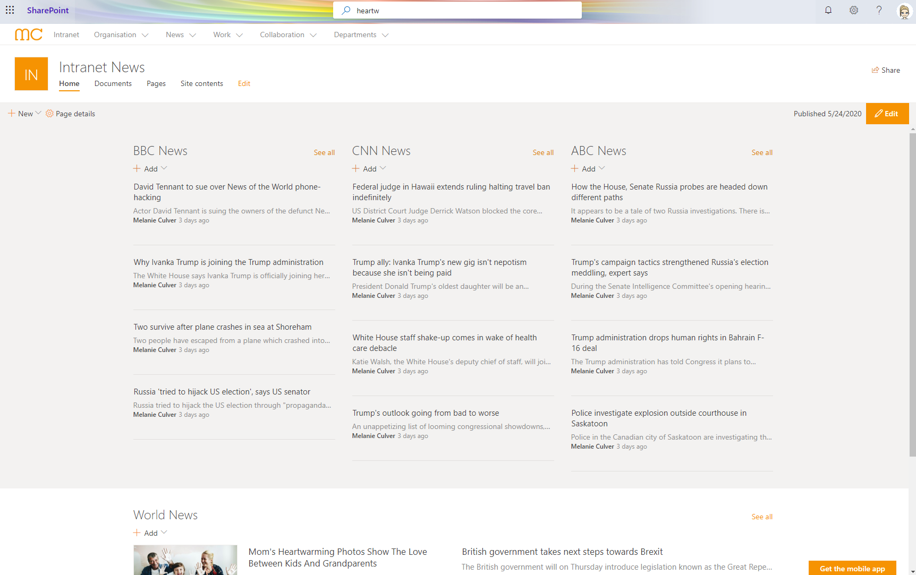
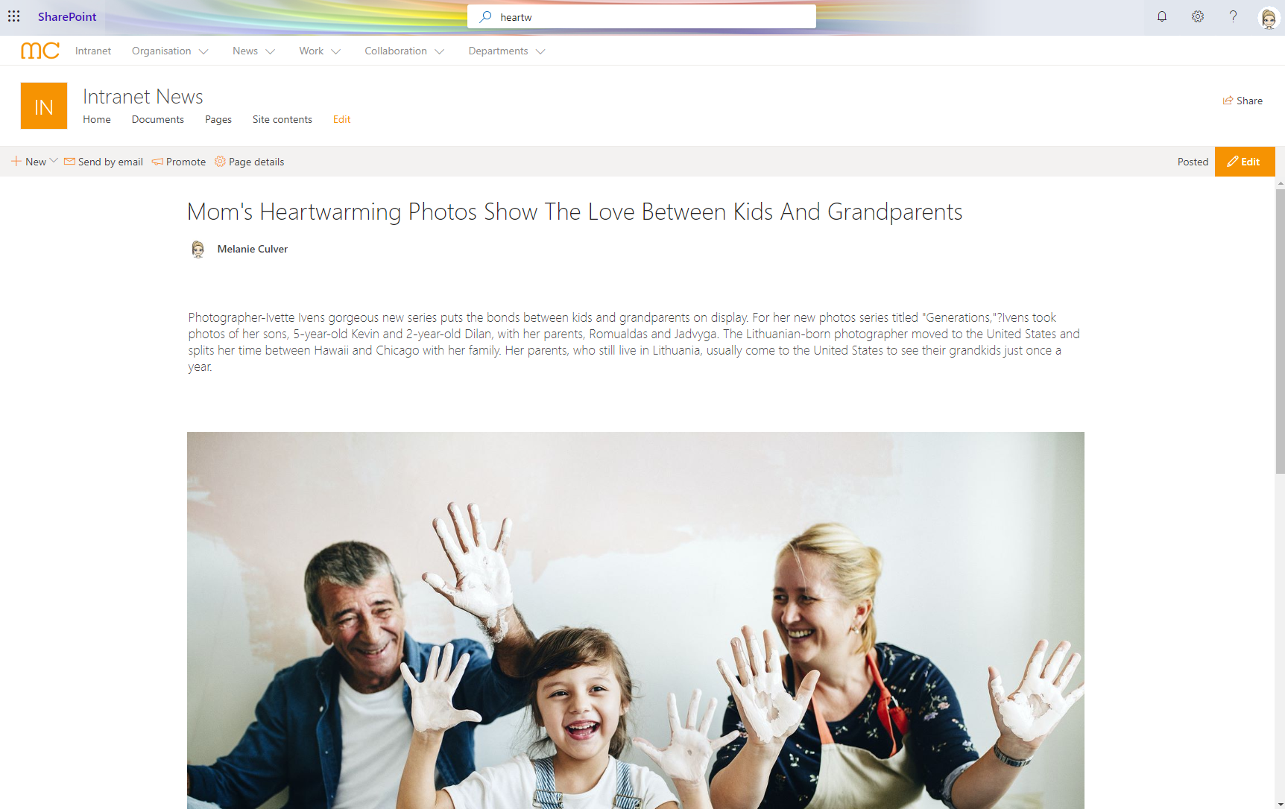

Slide 36
Demo
Notes:
Demo 2
How to transform your content with the PnP command lines
Show a full script example and run that
Demo 3
How can you integrate your new content on the homepage
Demo 4
Show how the other landing pages look like
e.g. knowledge base

Slide 37
Recap of Demos
Easy to migrate your content
Use the WebParts to aggregate your content (search)
PnP Modern Search Solution
Ideally only minor adjustments to your existing Intranet
Join your Communications sites with Hub Site

Slide 38
Challenges
Migration might be more complex
Page structure different
Additional migration steps required
Broken links
Comments and Likes not possible (at the moment)
PnP cmdlts
Hidden Fields
Caching

Slide 39
Changes
Look & Feel will be different
Page layouts not as restrictive
Switch between modern and classic
Navigation
look a little different
Maintain two different navigations
“Pre-”Publishing not possible

Slide 40
Final thoughts
Start looking and working with Communication Sites
Start small and evolve

Slide 41

THANK YOU FOR JOINING US!
DO YOU HAVE ANY QUESTIONS?
Let’s Connect: https://at.linkedin.com/in/culvermelanie
Brought to you by:
The Global Microsoft Community &
#M365VM
M365VirtualMarathon.com
M365Conf.com | #M365CONF

Slide 42
Images from https://www.microsoft.com , https://www.rawpixel.com/

